Slide 1

Neural Network

Slide 2
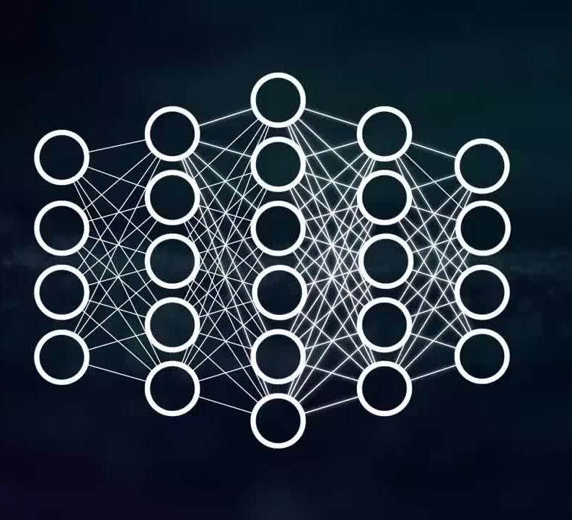
Nervous system
Neurons
Human brain
Layers: Input, Hidden, Output

Slide 3
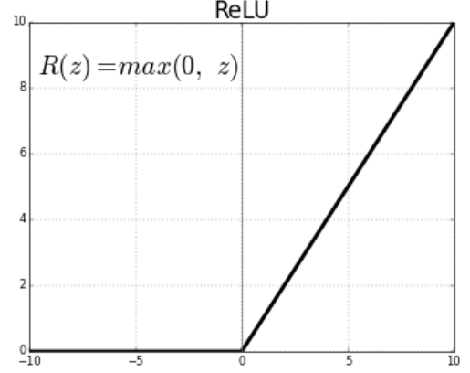
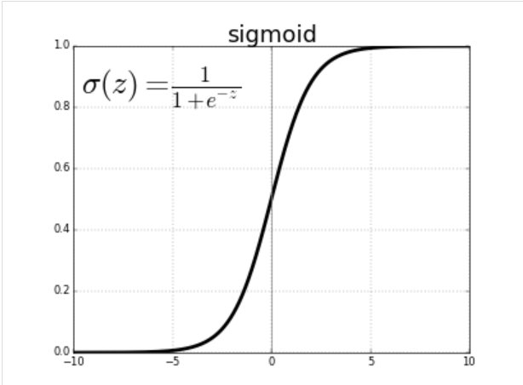
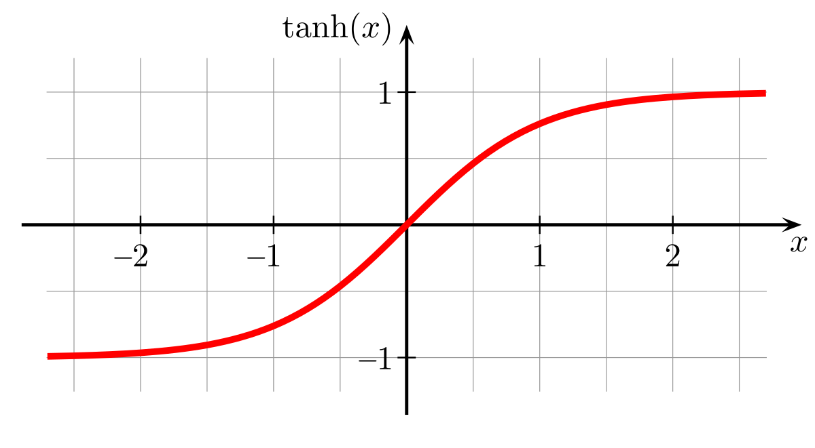
Activations Functions
Sigmoid
ReLU
Tanh

Slide 4
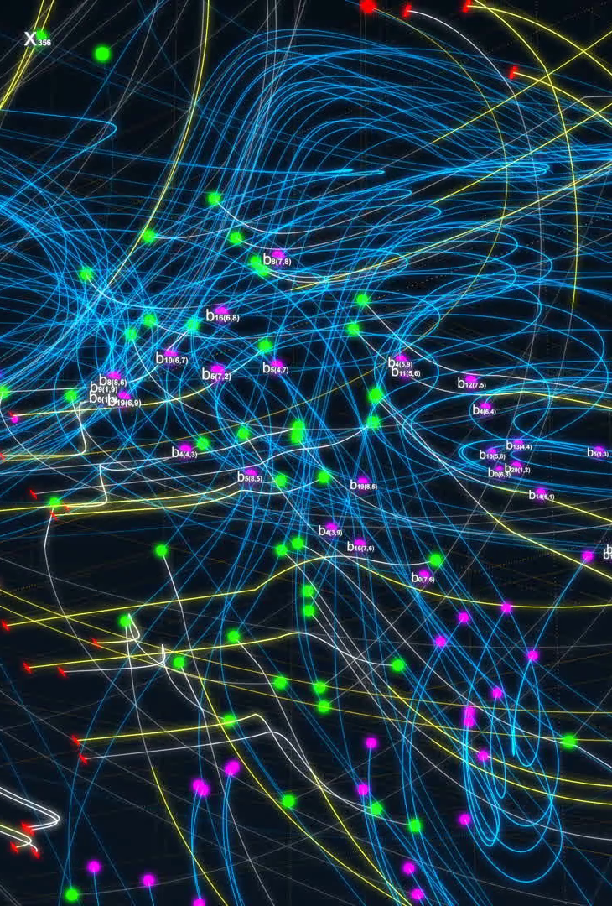
Neural network
Backpropagation
Feed-forward neural network
Recurrent neural networks
Convolutional neural network
Applications

Slide 5
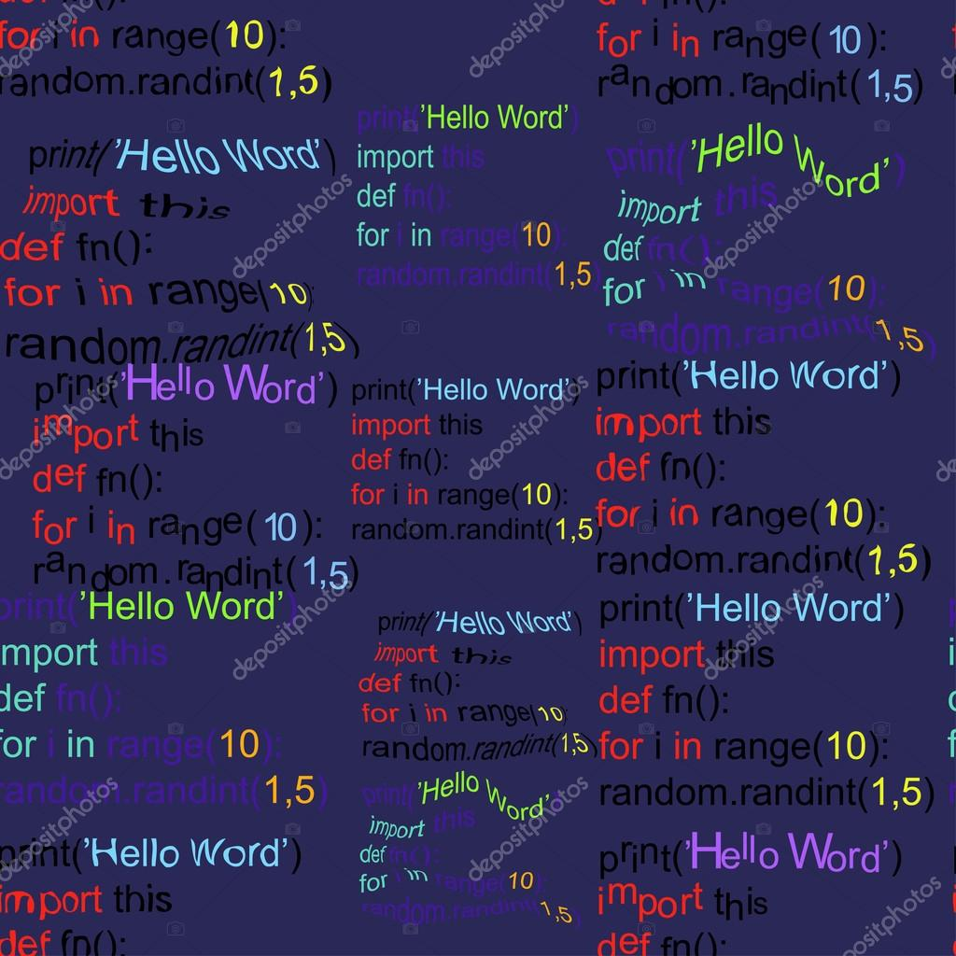
CODE

